Slide 1


Okay to Say
Implementing Okay to Say in the Workplace
Sean Norton
Public Information & Media Manager

Slide 2


Okay to Say in the Workplace
Two components
Internal Communication and Resources for Staff
  Emphasis on the importance of mental health.
  Break down the stigma and barrier of addressing mental health needs by
  integrating concept and language in our daily work and culture.
  Foster a “safe” environment where staff feel comfortable and reassured
  that it’s “okay to say.”
  Reinforce and complement your comprehensive benefits package by
  offering an Employee Assistance Program.
External/public endorsement of OTS campaign
  Encourages other organizations (public and private) to join the movement.
  Appeals to potential candidates by demonstrating an inclusive
  work environment.
  Provide additional resources to the community for accessing mental
  and/or behavioral health services.
  Finally, promote the Behavioral Health Leadership Team of Texoma
  and encourage membership in the initiative.

Slide 3

Implementation
Internal objectives
Provide a comprehensive list of resources staff can utilize to access care needs.
  Utilize internal communication tools such as intranet or newsletters.
    List should include contact information and basic description of service.
      24-hour assistance programs, counseling services, psychiatric services, testing/assessment
      services, alcohol/drug rehabilitation & treatment centers
    Provide Monthly Wellness Newsletters to address a wide scope of related topics.
Emphasize employee assistance program
  Through communication such as email and intranet posts, make a regular habit of reminding staff
  that this service is provided at no cost to the employee by the employer.
  Utilize EAP service to provide in-house training opportunities.
  Management utilization of employee referrals to EAP.
Promote OTS campaign in common workspaces
  Utilize the OTS toolkit to print posters and flyers for distribution to staff and to post on walls in
  break rooms, copy rooms, kitchens, etc.

Slide 4
Implementation
External objectives
Website page dedicated to OTS in the Workplace.
  OTS logo in footer of website linked to website page.
    Website page should clearly indicate organization supports OTS campaign.
      Be sure to provide disclaimer/notices and links back to Meadows MHPI website
      Provide basic instruction for how to Stand Up. Speak Out. And Make it Okay to Say.
      Provide link to In Your Area page for a list of community partners in your vicinity.
  Utilize images and resources provided in the Okay to Say toolkit for cohesive and consistent
  OTS brand application as defined by Meadows MHPI.
    Prior to publication, submit for review to Julie Almendral (jalmendral@texasstateofmind.org)
    Email info@okaytosay.org with your logo, website link & short description
    to be listed as a partner on the OTS website.
Meadows Mental Health Policy Institute
Julie Almendral
Communications & Multimedia Manager
jalmendral@texasstateofmind.org
(917) 974-7053
Access the Okay to Say toolkit
www.okaytosay.org/toolkit
Login: OTSPartner
Password: Okaytosay2018

Slide 5

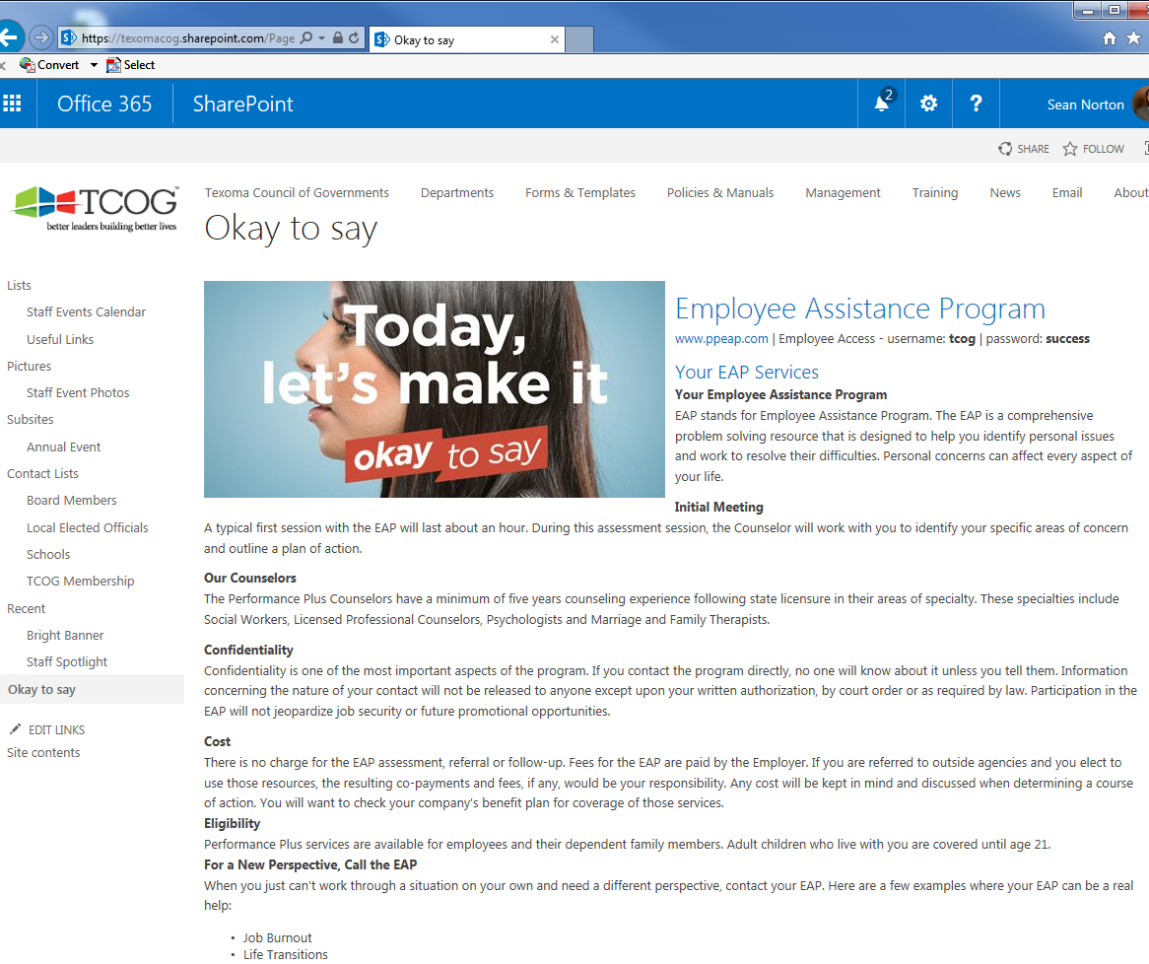
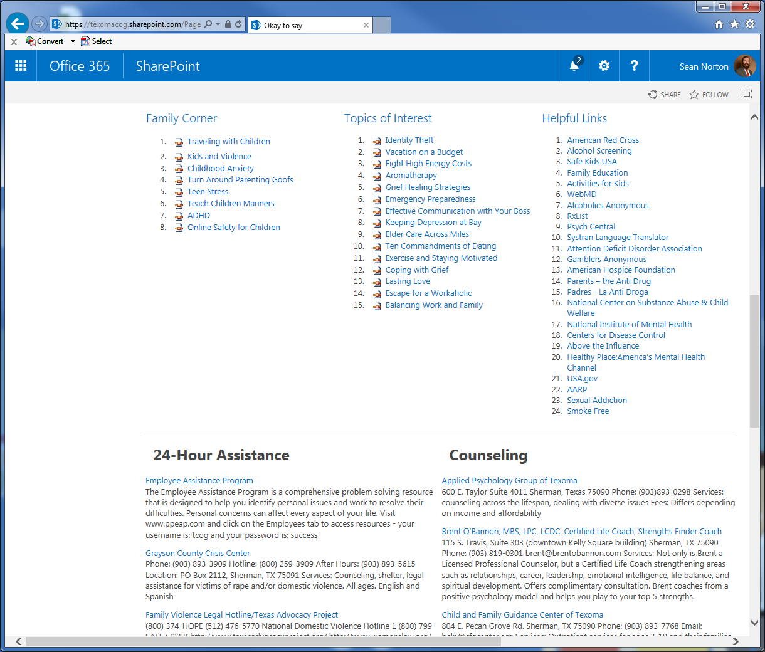

Okay to Say in the Workplace

Slide 6

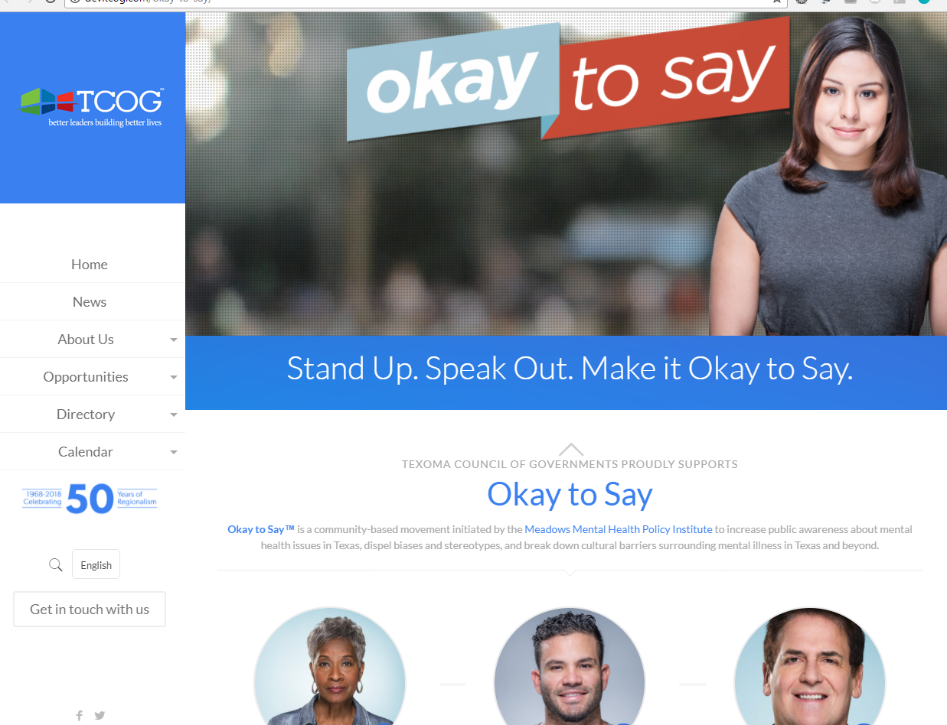
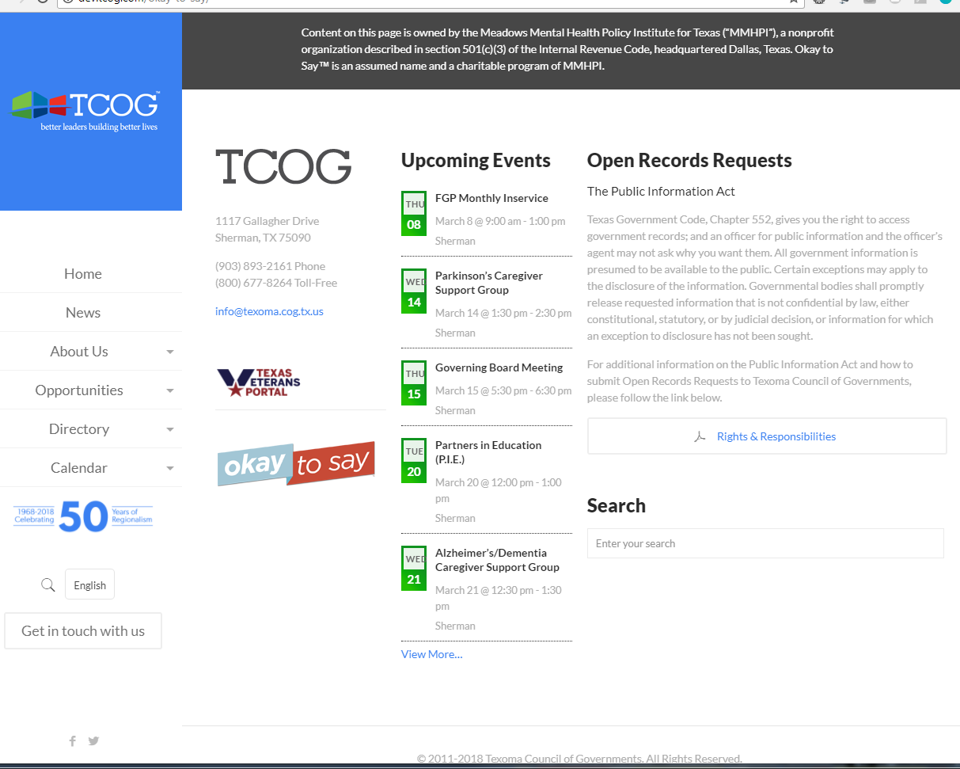
Okay to Say in the Workplace

Slide 7





Okay to Say in the Workplace

